Slide 1
GETTING STARTED WITH APIS
Rob Spectre, Brooklyn Hacker
@dN0t – rob@brooklynhacker.com

Slide 2
THIS IS YOU

Slide 3
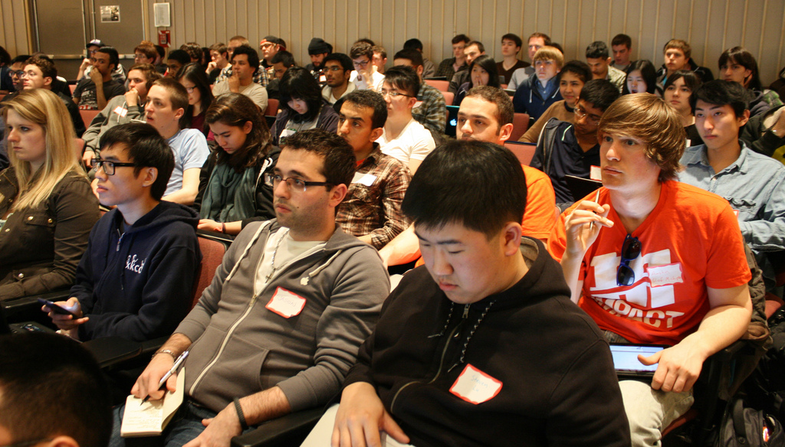
READY TO GO

Slide 4
THIS WILL BE YOU

Slide 5
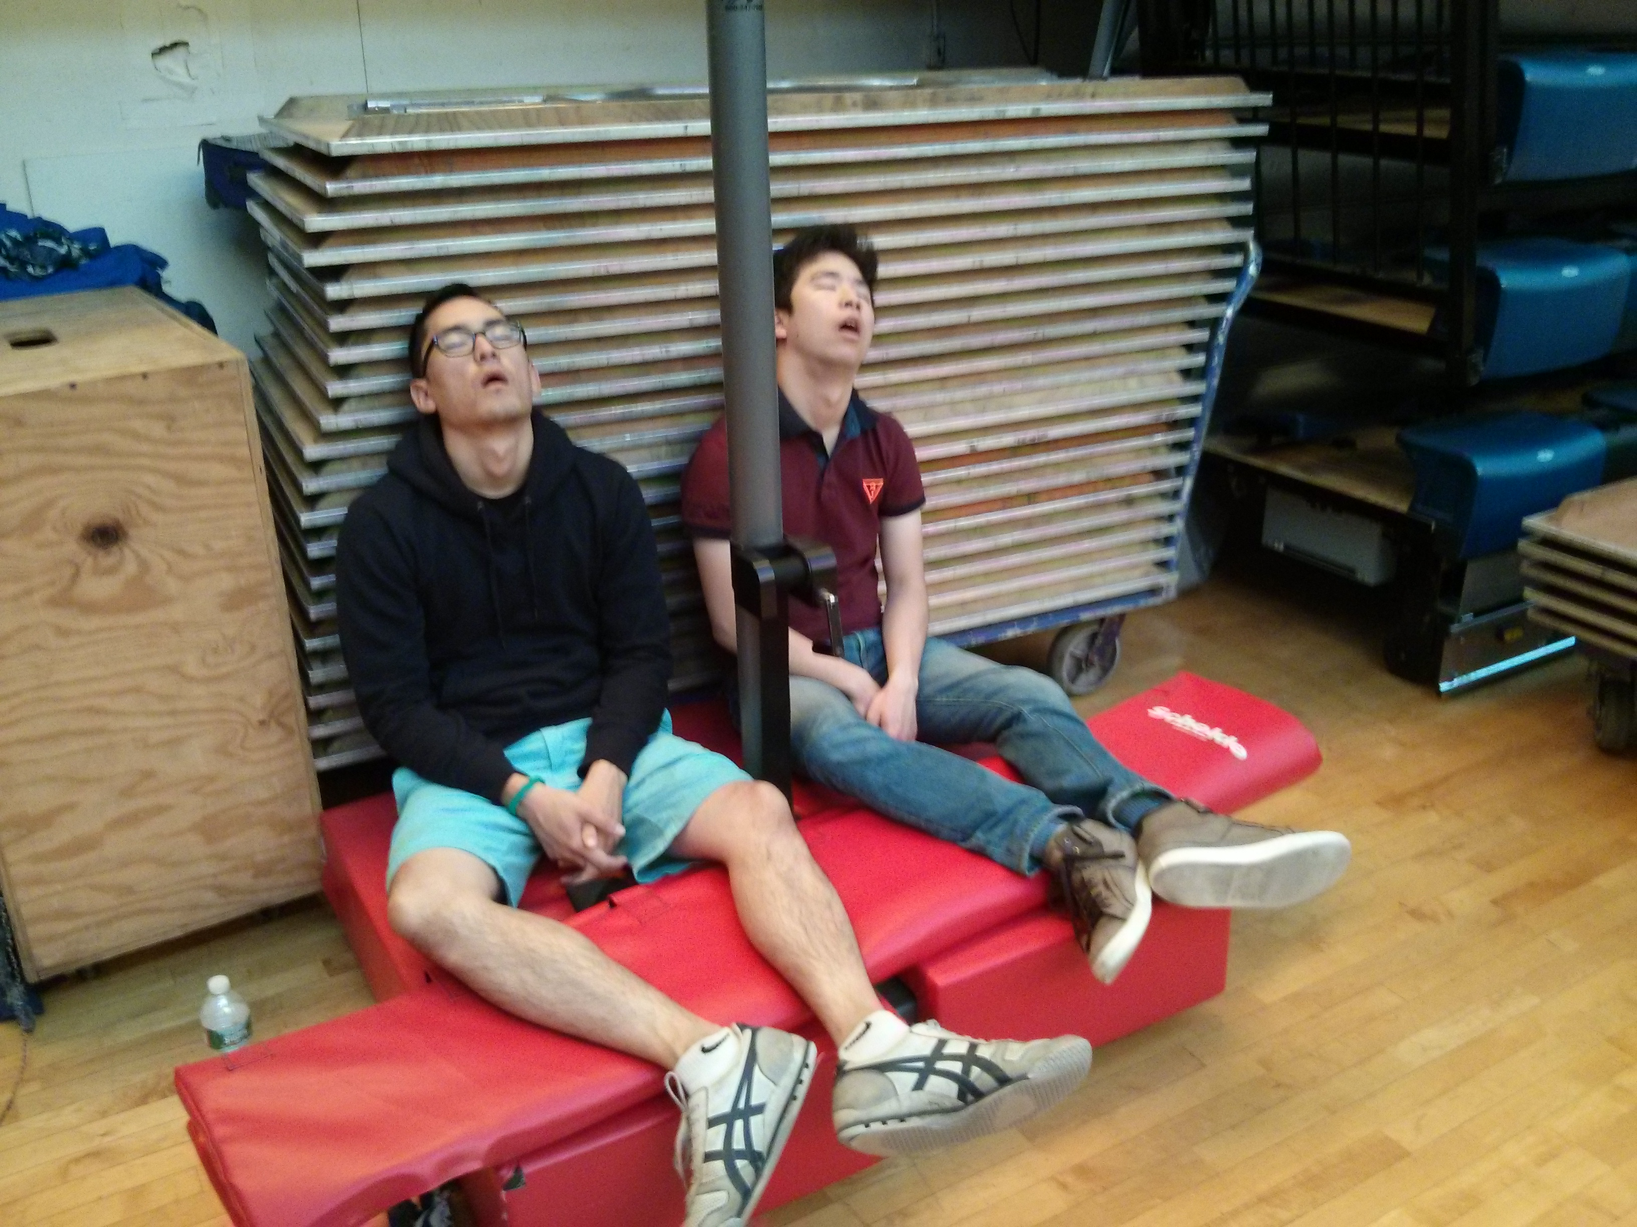
NOT SO MUCH

Slide 6
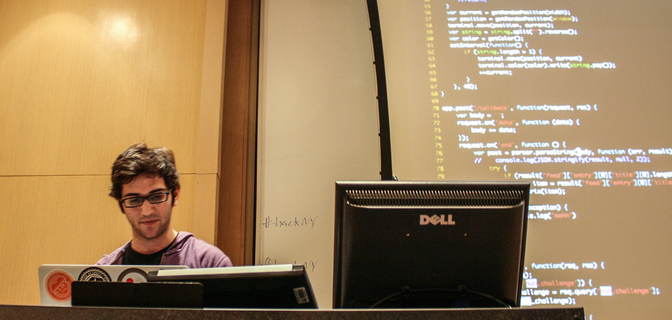
AMAZING THINGS

Slide 7
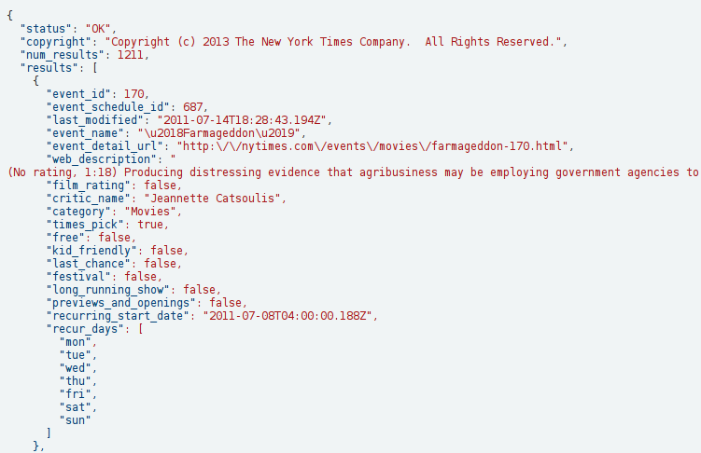
AMAZING UTILITY

Slide 8
O HAI

Slide 9
CONCEPTS
LANDSCAPE
TOOLS
GETTING STARTED WITH APIS

Slide 10
API

Slide 11
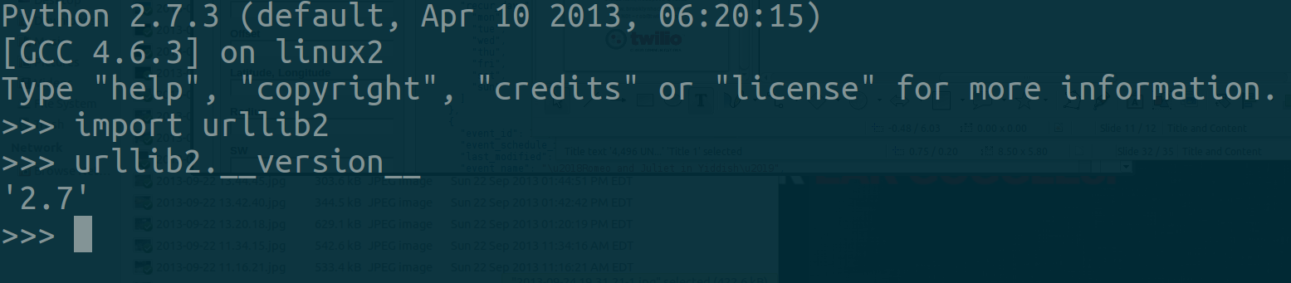
YOU'RE ALREADY USING THEM

Slide 12
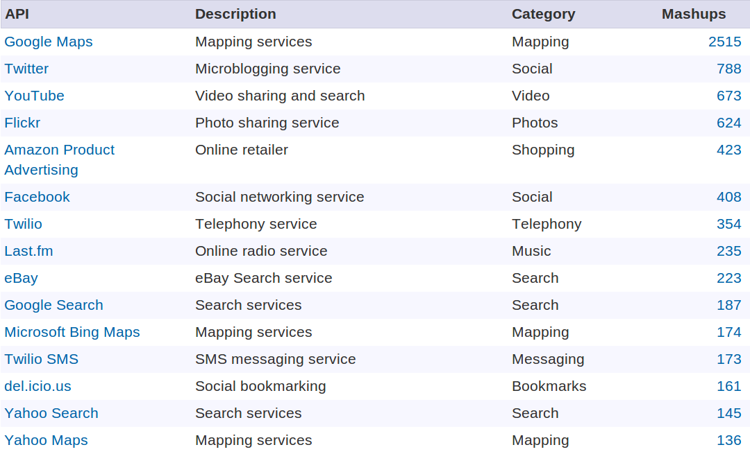
WEB SERVICES

Slide 13
REST

Slide 14
ZZZZZZ

Slide 15

NEW YORK TIMES

Slide 16

TUMBLR

Slide 17
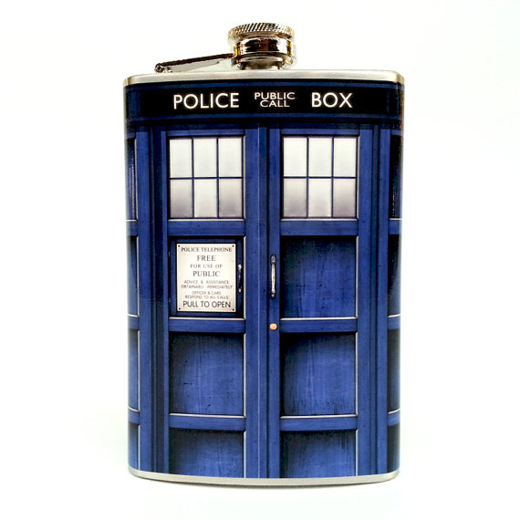
ETSY

Slide 18

TWILIO

Slide 19
WEBHOOKS

Slide 20

LIKE HOOKS FOR THE WEB!

Slide 21
Some API
Your App
WEBHOOKS IN ACTION

Slide 22
Some API
Your App
Something
you
want
WEBHOOKS IN ACTION

Slide 23
Some API
Your App
Something
you
Want rev2
WEBHOOKS IN ACTION

Slide 24
Has it changed?
Some API
Your App
Something
you
want
No.
!WEBHOOKS

Slide 25
Has it changed?
Some API
Your App
Something
you
want
Still no.
!WEBHOOKS

Slide 26
Has it changed?
Some API
Your App
Something
you
want
No!
!WEBHOOKS

Slide 27
Has it changed?
Some API
Your App
Something
you
want
Bro. Settle.
!WEBHOOKS

Slide 28
Has it changed?
Some API
Your App
Something
you
Want v2
YES!
JESUS!
!WEBHOOKS

Slide 29
Hey. Can you let me know when something changes?
Some API
Your App
Something
you
want
Sure.
WEBHOOKS

Slide 30
Some API
Your App
Something
you
want
WEBHOOKS

Slide 31
Some API
Your App
Something
you
Want rev2
Yo. Something changed.
WEBHOOKS

Slide 32

FOURSQUARE

Slide 33

SENDGRID

Slide 34
STREAMING

Slide 35

DATA FLOW

Slide 36
Some API
Your App
Something
you
want
STREAMING IN ACTION

Slide 37
Some API
Your App
∞
Something
you
want
STREAMING IN ACTION

Slide 38
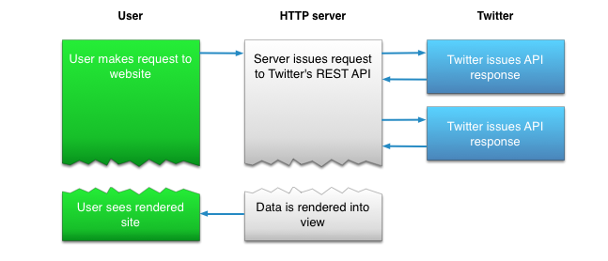
TWITTER

Slide 39
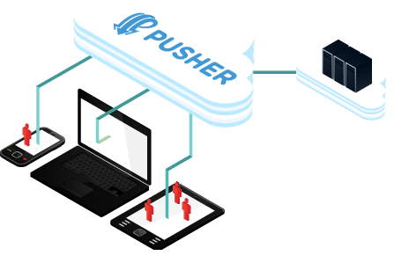
PUSHER

Slide 40
XML / JSON

Slide 41

SERIALIZATION

Slide 42
Some API
Your App
SERIALIZATION

Slide 43


Ruby
Python
SERIALIZATION

Slide 44
Ruby
Python
SERIALIZATION

Slide 45
Ruby
Python
json
HTTP
xml
SERIALIZATION

Slide 46
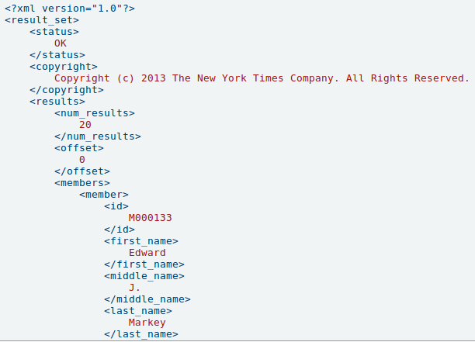
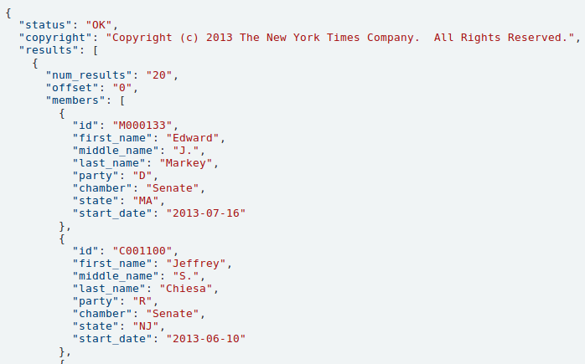
XML / JSON

Slide 47
PYTHON: BeautifulSoup
RUBY: Nokogiri
PHP: SimpleXML
NODE: xml2js
GOOD XML PARSERS

Slide 48
LANDSCAPE

Slide 49
TWILIO

Slide 50
SENDGRID

Slide 51

PUSHER

Slide 52
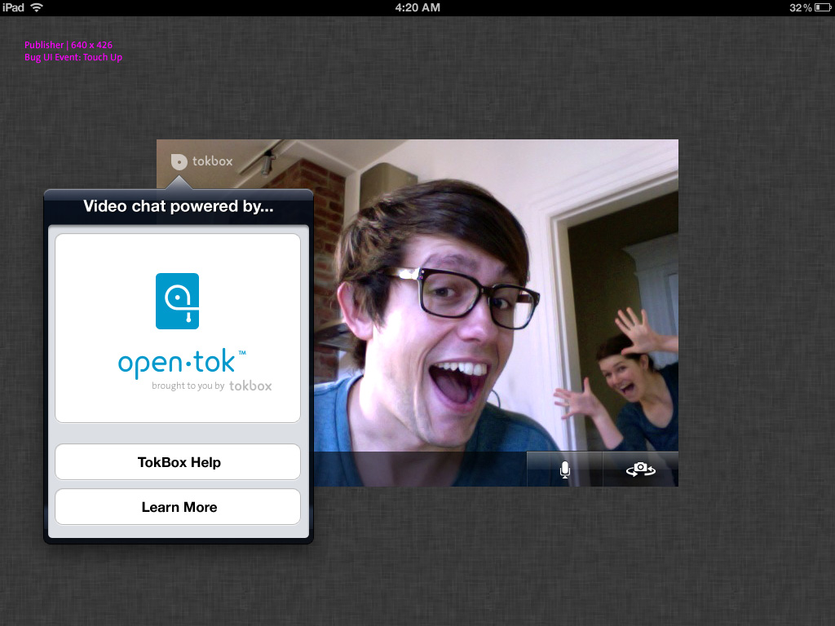
OPENTOK

Slide 53

ECHONEST

Slide 54

GOOGLE MAPS

Slide 55

MASHERY

Slide 56
TOOLS

Slide 57
STANDARD
LIBRARY
DON'T USE ME

Slide 58

HELPER LIBRARIES

Slide 59
PYTHON: requests
RUBY: httparty
PHP: Guzzle
JAVA: Google HTTP Client
.NET: RestSharp
NODE.JS: request
PLAN B: HTTP CLIENTS

Slide 60

REINVENTING THE WHEEL

Slide 61
PYTHON: django
RUBY: rails
PHP: yii, symfony
JAVA: play
.NET: MVC.NET
SINK: FRAMEWORKS

Slide 62
PYTHON: flask
RUBY: sinatra
PHP: laravel
JAVA: spark
NODE.JS: express
NO SINK: FRAMEWORKS

Slide 63

OAUTH

Slide 64
INTEGRATION

Slide 65

DO IT LIVE

Slide 66
DESIGN

Slide 67
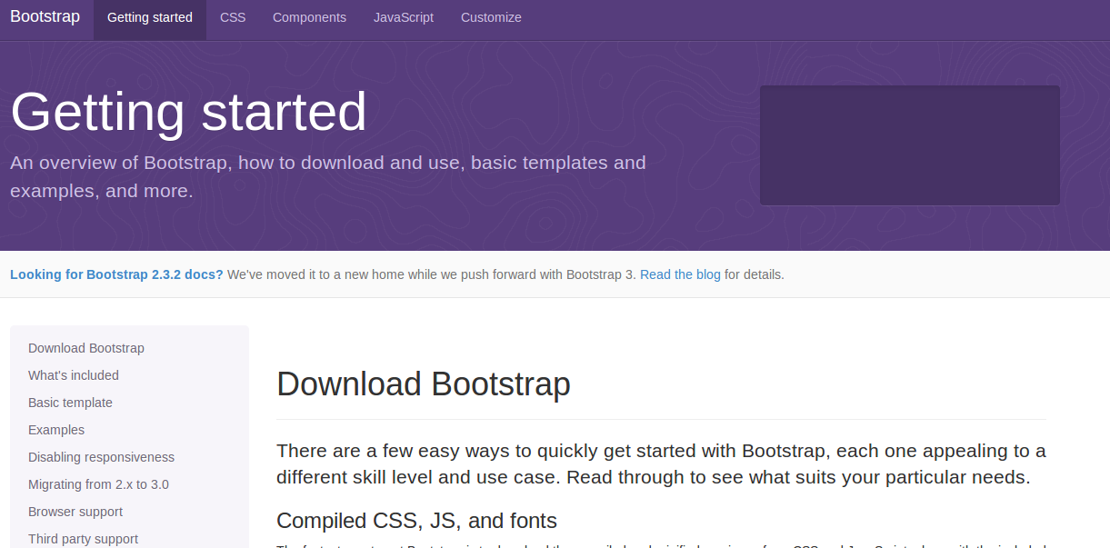
YOU'LL SEE A LOT OF THIS

Slide 68

ZURB FOUNDATION

Slide 69
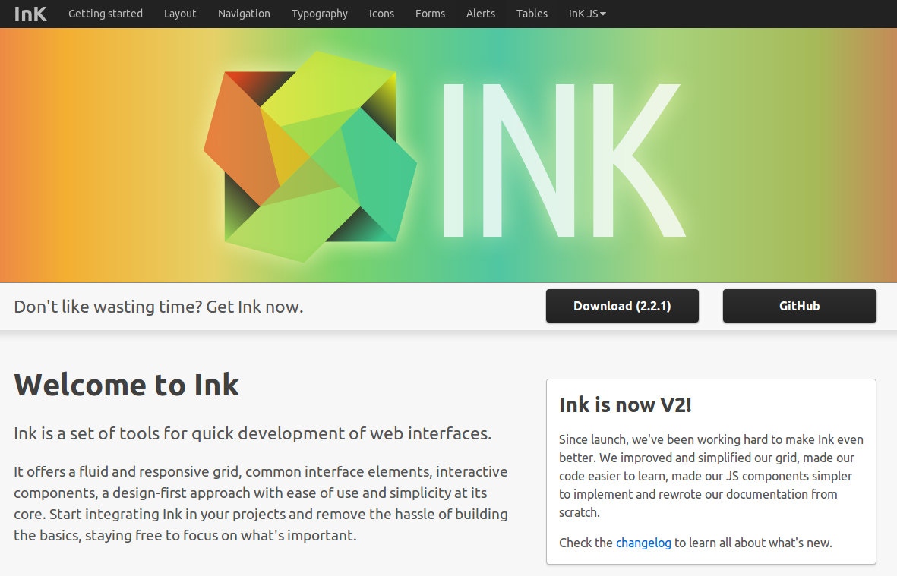
InK

Slide 70
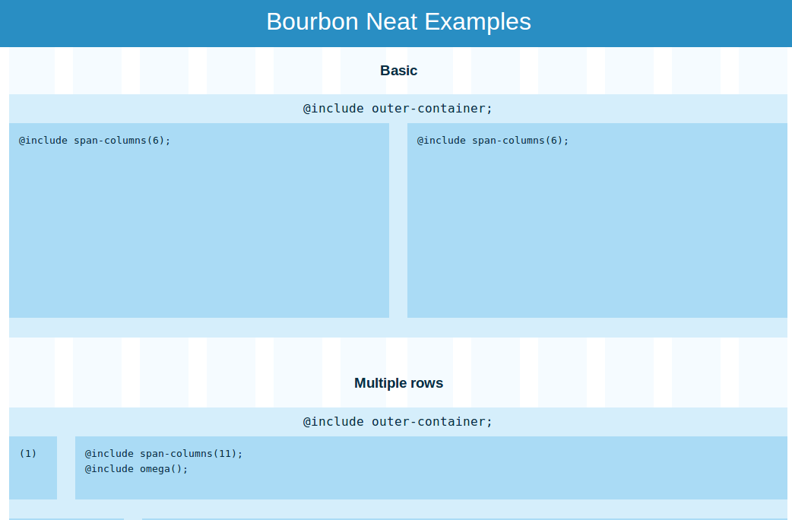
BOURBON NEAT

Slide 71
DEPLOY

Slide 72

SIMPLE DEPLOYMENT

Slide 73

NODE AND WEBSOCKETS

Slide 74

GOOGLE APP ENGINE

Slide 75

PARSE

Slide 76

FIREBASE

Slide 77
THANK YOU
Github.com/RobSpectre/Talks
www.brooklynhacker.com
@dN0t – rob@twilio.com

